Slide 1


17 March 2020
Universidade de Aveiro
Engenharia de Computadores e Telemática
Interação Humano-Computador
2019/2020
Bruno Caseiro 88804
Mateusz Roganowicz 96947
Ruben Menino 89185
Teacher: Beatriz Sousa Santos
Class:
P1

Slide 2
Why Ticketline?
Portugal’s most popular ticketing platform
A lot of use cases (buy tickets, check time and date, check seat availability, etc..)
Below average UX

Slide 3
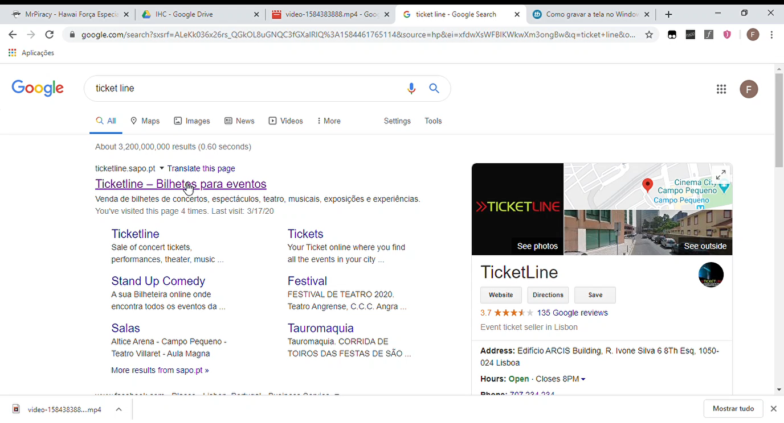
About ticketline

Slide 4
About Ticketline
What is it?
Ticketline is a portuguese ticketing platform where you can buy tickets for concerts, theater plays, exhibitions and many other types of shows.
What are its objectives?
Ticketline’s main goal is to provide an easy way for people to buy tickets from their phone or computer.

Slide 5
About Ticketline
Who is the target audience?
People in Portugal interested in the several types of shows mentioned before.
What are its main UI aspects?
Lots of posters representing each show’s buying page. In the form of slideshow and lists, mostly.

Slide 6
Heuristic Evaluation
All 3 of us explored the features of the website
Each tried to complete several tasks which an average user would
Every usability problem was reported to the team
Cognitive Walkthrough
Lots of posters representing each show’s buying page. In the form of slideshow and lists, mostly.

Slide 7
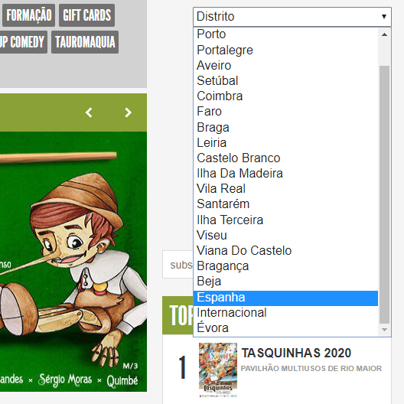
Heuristic Evaluation
- Issue: “International” and “Spain” show up in the district dropdown menu
- Heuristic: 4 = Consistency and standards
-Severity: 2 = Minor usability problem

Slide 8
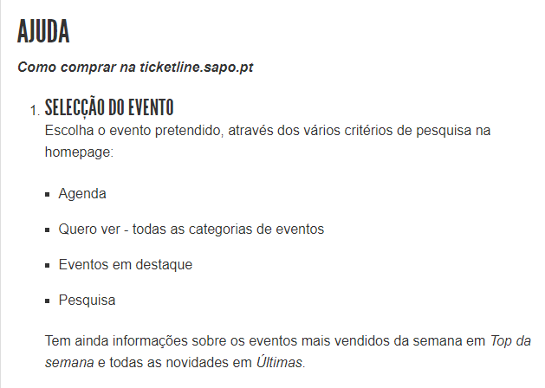
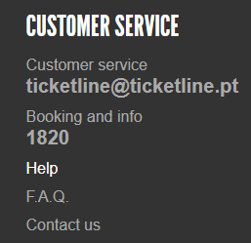
Heuristic Evaluation
- Issue: Help page is given always portuguese
- Heuristic: 10 = Help and documentation
- Severity: 3 = Major usability problem

Slide 9

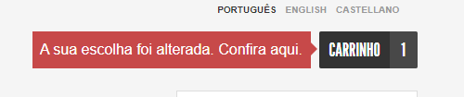
Heuristic Evaluation
- Issue: Cart doesn’t expire, nothing changes after the 10 minutes
- Heuristic: 2 = Match between system and the world
- Severity: 2 = Minor usability problem

Slide 10
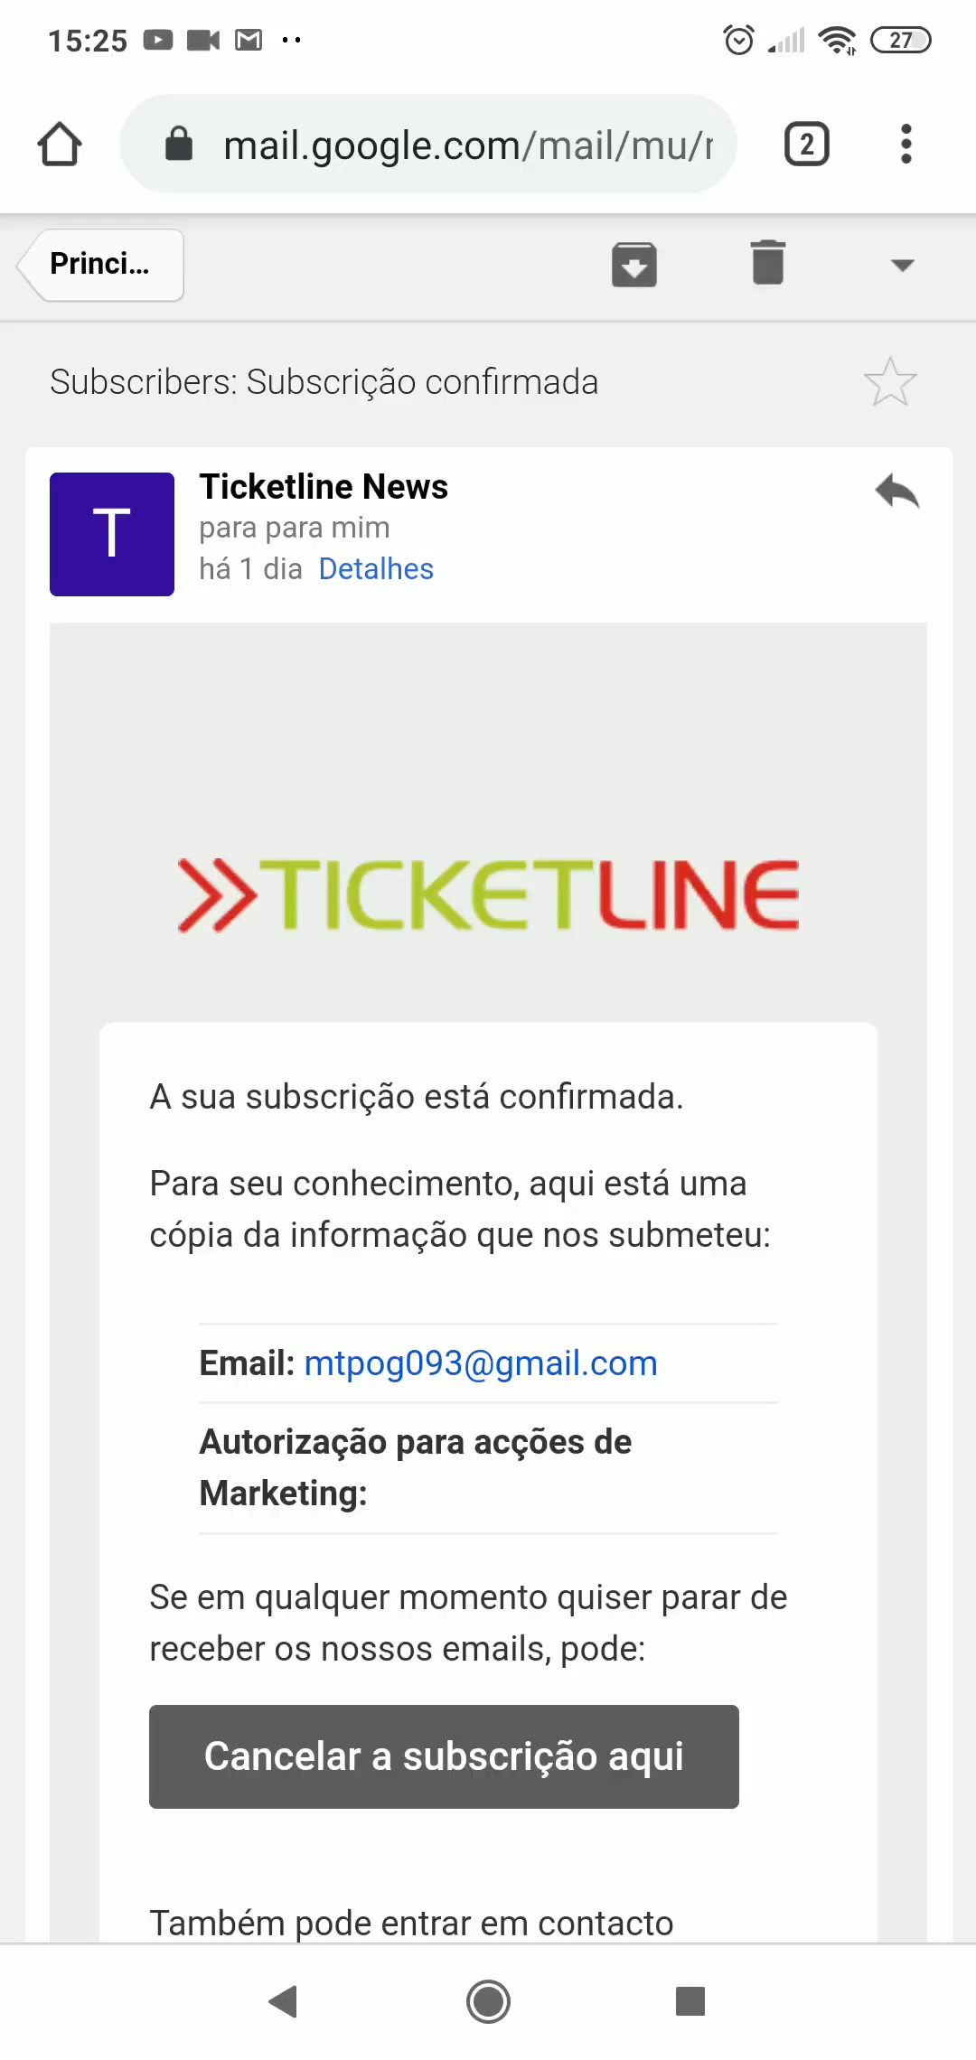
Heuristic Evaluation
- Issue: Unsubscribe newsletter allows you to delete any email
- Heuristic: 5 = Error prevention
- Severity: 4 = Usability Catastrophe

Slide 11
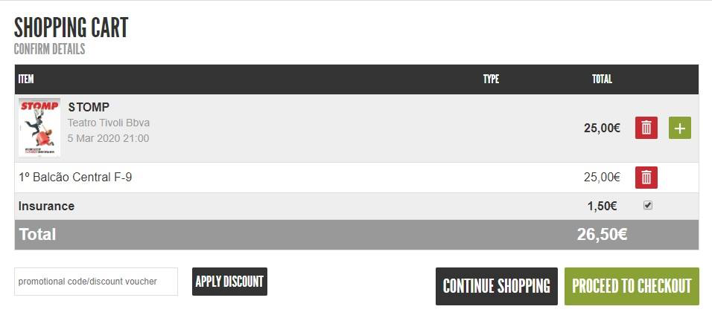
Heuristic Evaluation
- Issue: Insurance button disappears once clicked
- Heuristic: 3 = User control and freedom
- Severity: 4 = Usability Catastrophe

Slide 12
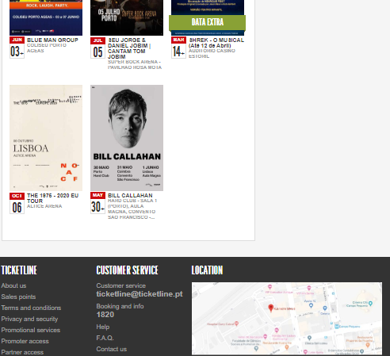
Cognitive Walkthrough
- Task: Find the “help” section of the website
- User: Someone in need of help browsing Ticketline
- Issue: Link is very small, only found at the bottom of the page
The user will probably take a while to find the link!

Slide 13
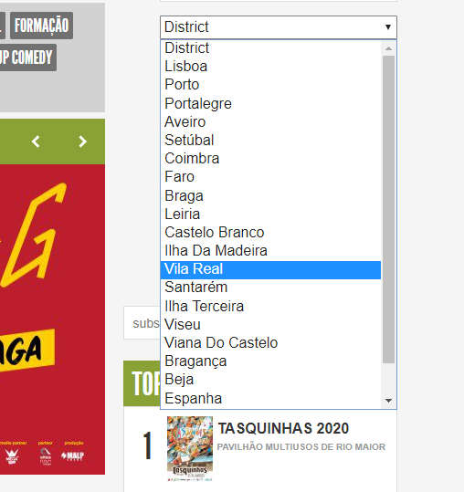
Cognitive Walkthrough
- Task: Search for events in Beja
- User: Someone looking to buy tickets in Beja
- Issue: Districts are not in alphabetical order. Most users will look for Beja at the top of the list.

Slide 14
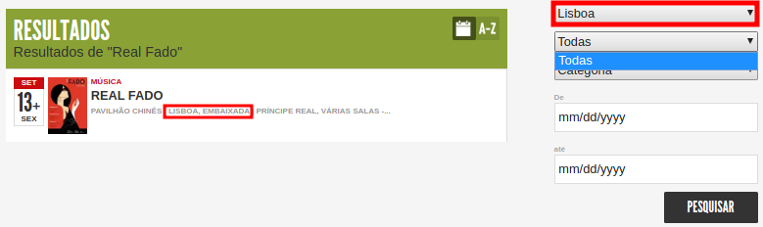
Cognitive Walkthrough
- Task: Search for events in a venue of Lisbon
- User: Someone looking at events in a venue of Lisbon
- Issue: List of Lisbon venues is empty, even though the event “Real
Fado” will be held in Lisbon.
*Screenshot of search results for “Real Fado”

Slide 15
Usability problems summary
Usability Problems | Mateusz | Bruno | Ruben | Median
Wrong districts (Internacional and Spain) | 2 | 2 | 2 | 2
Help page is given always portuguese | 3 | 3 | 3 | 3
Cart doesn’t expire, nothing changes after the 10 minutes | 2 | 2 | 2 | 2
Irrelevant dates (year 2051) | 3 | 2 | 2 | 2
Insurance button disappearing | 4 | 4 | 3 | 4
When searching by district, no venues show up | 3 | 3 | 2 | 3
Latest news are always in Portuguese | 3 | 3 | 3 | 3
Unsubscribing any email | 4 | 4 | 4 | 4
Difficult to find help button | 2 | 2 | 3 | 2
Price isn't shown correctly, because of transaction costs | 2 | 3 | 3 | 3
Sorting by date, list starts in August | 2 | 2 | 2 | 2
Some parts of some pages are in English, others in Portuguese | 3 | 3 | 3 | 3

